Slide 1
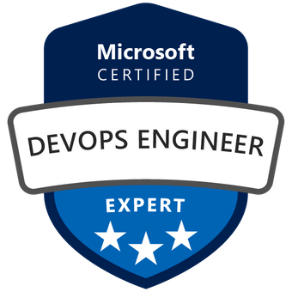
Exam AZ-400: Microsoft DevOps Solutions Crash Course
Tim Warner @TechTrainerTim

Slide 2

Tim Warner
Based in Nashville, TN, US
MCT, former MVP
Senior Content Developer, Microsoft
Twitter: @TechTrainerTim
Badge: TechTrainerTim.com

Slide 3
Session 1 of 2 Learning Goals
Azure DevOps intro
Git source control
CI/CD (start)

Slide 4
Session 2 of 2 Learning Goals
CI/CD (finish)
IaC
Artifacts
Monitoring

Slide 5
Course Materials
timw.info/az400

Slide 6
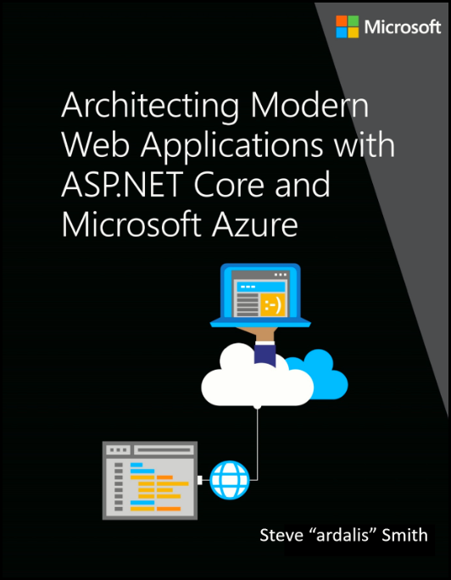
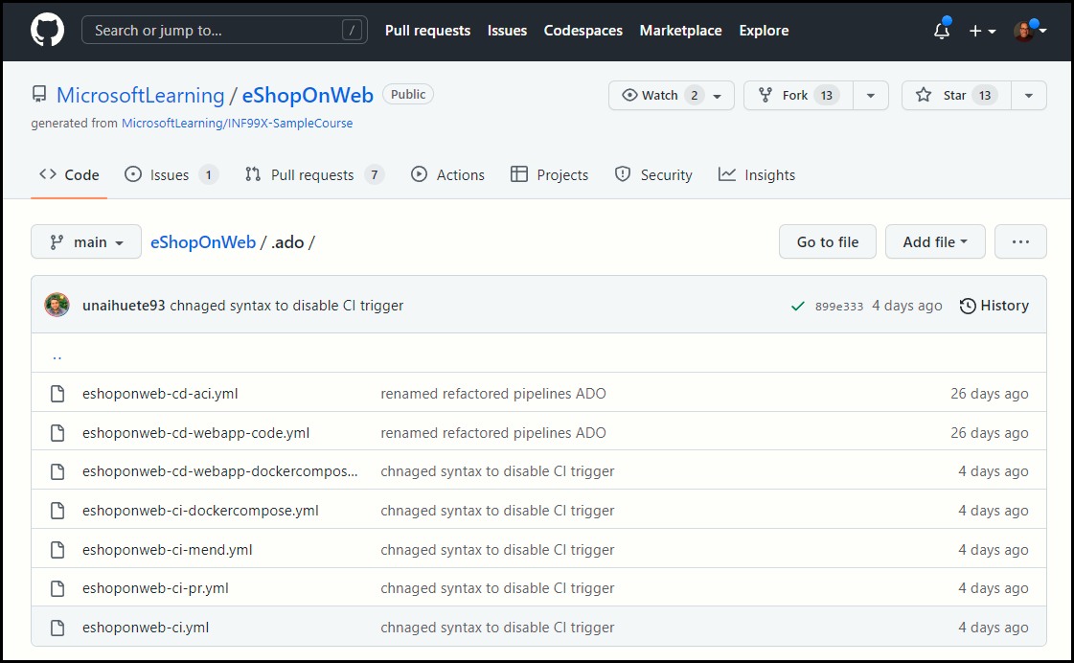
Free Microsoft Learning Resource

Slide 7
Setting Expectations
This is a six-hour "crash course"
Please plan to review these materials more than once
10-minute break at midpoint
Please ask/answer questions and provide feedback in the Q/A panel, not the group chat
I'll post outstanding questions/answers to my Twitter feed: @TechTrainerTim

Slide 8

A Surgical Approach
We cut closely to the exam objectives and precisely what information you need to know to clear the AZ-400 exam (respecting NDA, of course)
The AZ-400 exam is a mile wide and a foot deep

Slide 9

Session Recordings

Slide 10

Session Recordings

Slide 11

Session Recordings

Slide 12


Mobile Browser: learning.oreilly.com

Slide 13



O'Reilly Mobile App

Slide 14
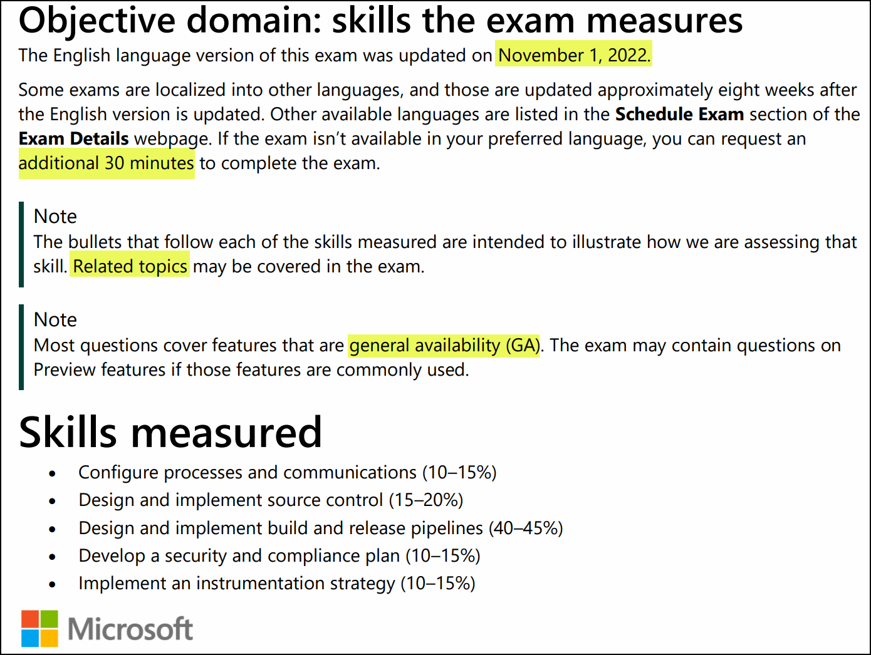
Exam AZ-400 Updates

Slide 15
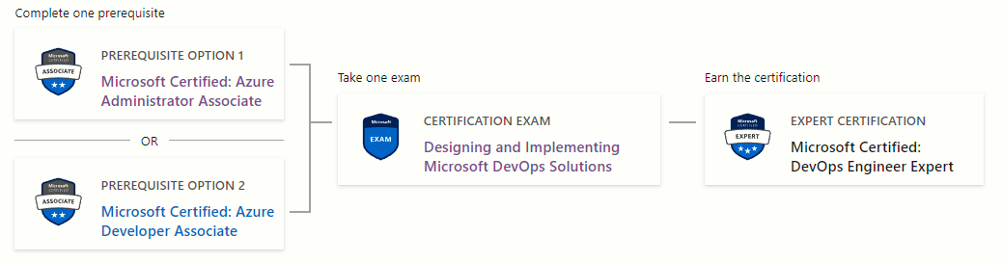
DevOps Engineer Expert Certification
AZ-104
AZ-400
AZ-204

Slide 16

Tim's Certification Study Model

Slide 17
Thank you!
Course materials: timw.info/az400
Twitter: @TechTrainerTim
Work: timw.info/ps
Web: TechTrainerTim.com

Slide 18
Source Control and SRE Strategy

Slide 19
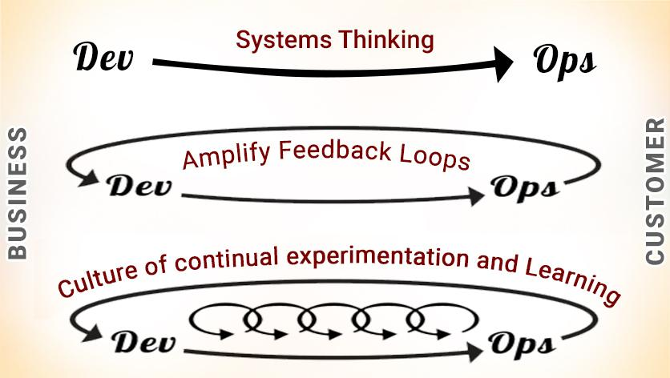
DevOps - The Three Ways

Slide 20

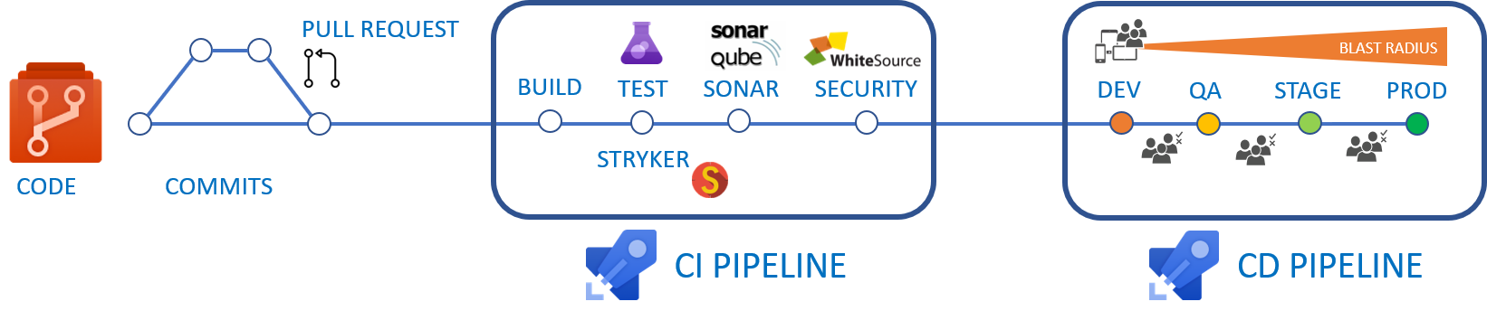
CI/CD Pipelines

Slide 21
Formats 'n' Languages
Data formats
JSON
YAML
Languages
Azure PowerShell
Azure CLI
Dockerfile
KQL

Slide 22
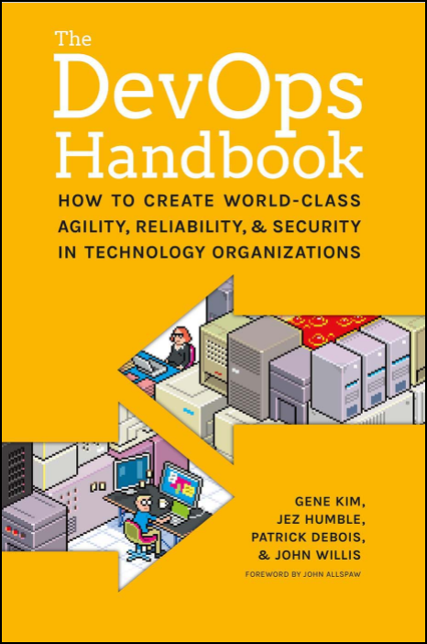
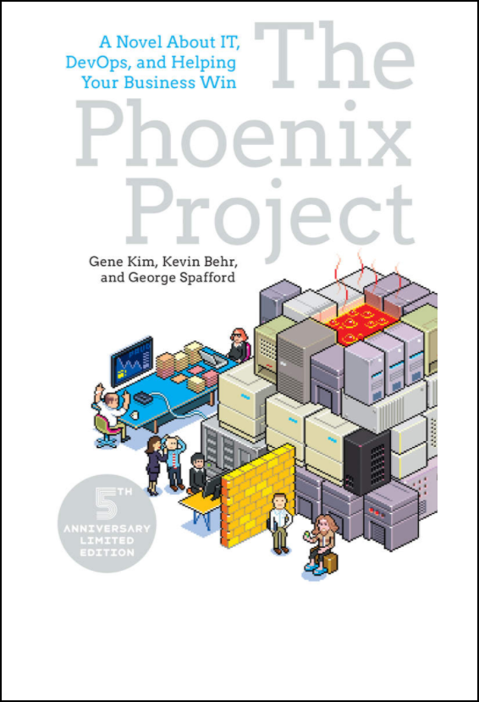
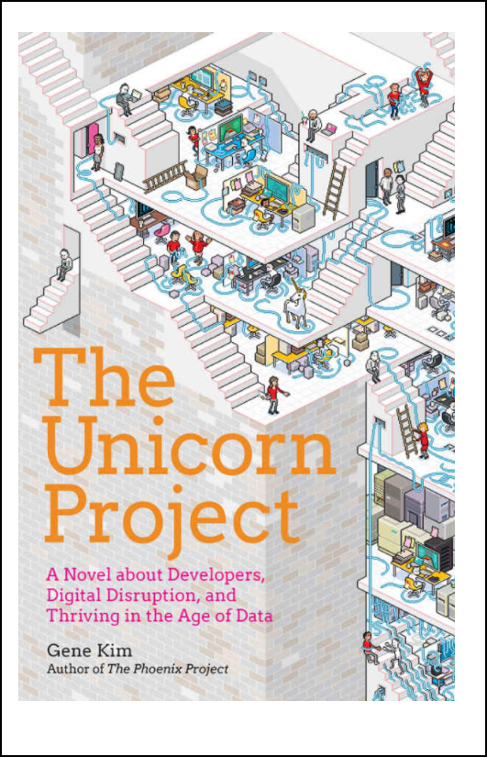
DevOps Reading List

Slide 23
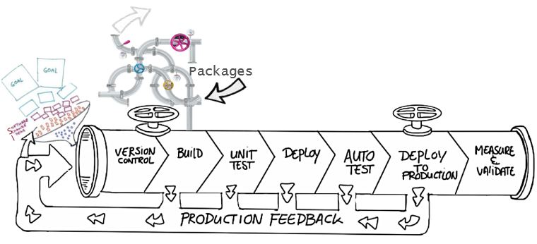
Benefits of source control
Create workflows
Work with versions
Collaboration
Maintains history of changes
Automate tasks
Notes:
Benefits include: Reusability, traceability, manageability, efficiency, collaboration, and learning

Slide 24
Distributed source control
Strengths | Best Used for
Cross platform support An open-source friendly code review model via pull requests Complete offline support Portable history An enthusiastic growing user based | Smaller size (in bytes) and modular codebases Evolving through open-source Highly distributed teams Teams working across platforms Greenfield codebases
Distributed
Every developer clones a copy of a repository and has the full history of the project.
Common distributed source control systems are Mercurial, Git, and Bazaar.
Notes:
A greenfield project is one that lacks constraints imposed by prior work.

Slide 25
Centralized source control
Strengths | Best Used for
Easily scales for very large codebases Granular permission control Permits monitoring of usage Allows exclusive file locking | Large integrated codebases Audit and access control down to the file level Hard to merge file types
Centralized
There is a single central copy of your project, and programmers commit their changes to this central copy.
Common centralized source control systems are TFVC, CVS, Subversion (or SVN), and Perforce.

Slide 26
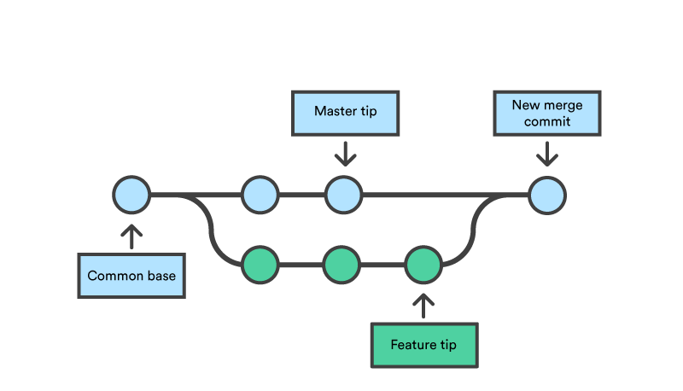
Feature Branching and Merging

Slide 27
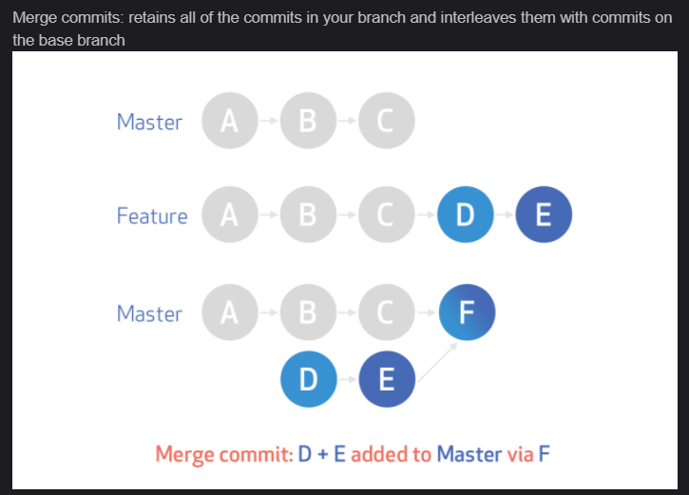
Merge commits
https://timw.info/k0n

Slide 28
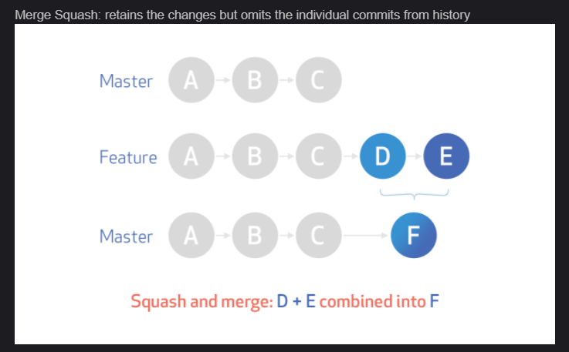
Merge squash
https://timw.info/k0n

Slide 29
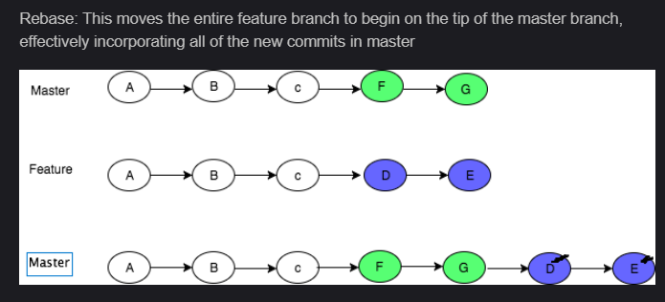
Rebase
https://timw.info/k0n

Slide 30
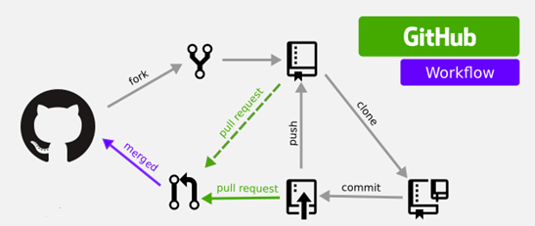
GitHub Workflow

Slide 31
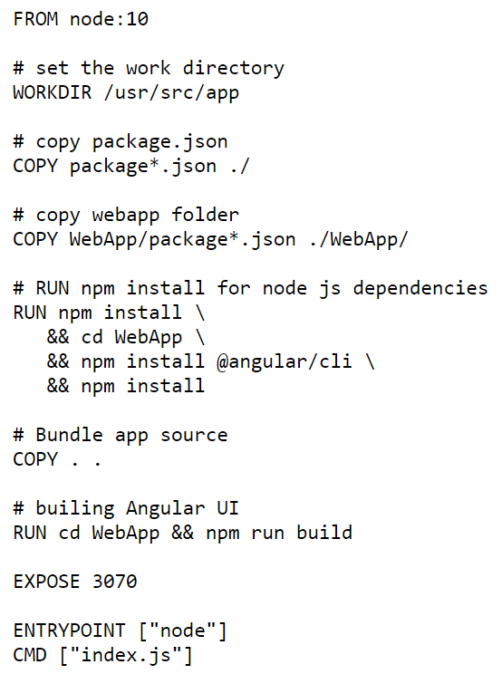
Single-Stage Dockerfile

Slide 32
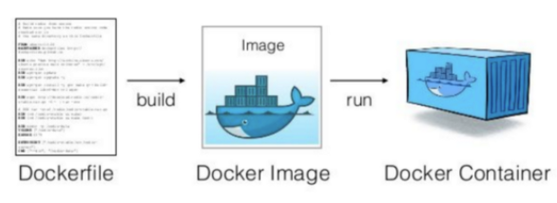
Docker Container Development Process

Slide 33
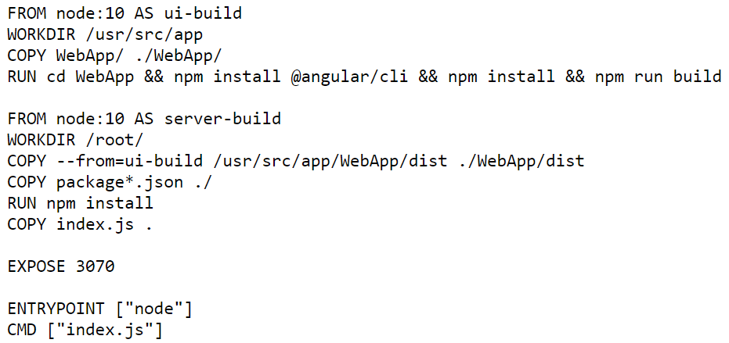
Multi-Stage Dockerfile

Slide 34
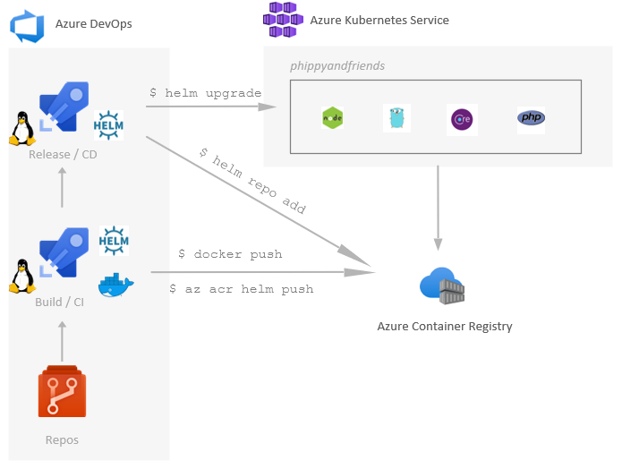
Helm, ACR, and AKS

Slide 35
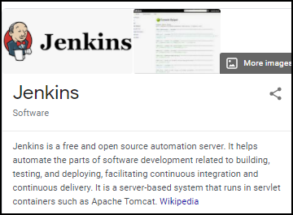
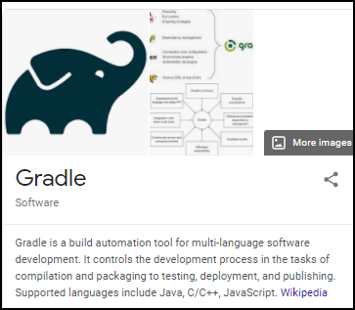
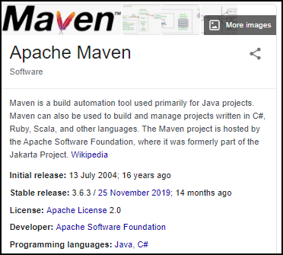
Build Engines

Slide 36
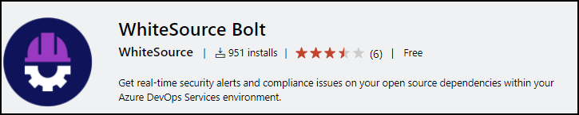
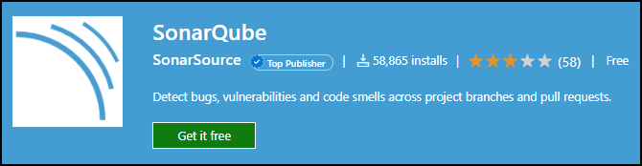
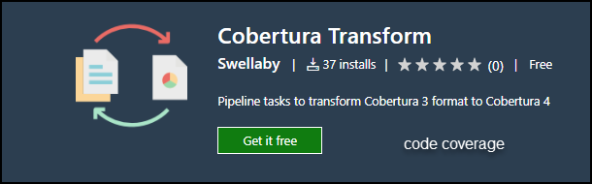
Code Testing Extensions

Slide 37
Sources and impacts of technical debt
Common sources of technical debt are:
Lack of coding style and standards
Over-engineering code
Lack of or poor design of unit test cases
Insufficient comments and documentation
Ignoring or not understanding object orient design principles
Not writing self-documenting code
Monolithic classes and code libraries
Taking shortcuts to meet deadlines
Poorly envisioned use of technology, architecture and approach
Leaving dead code in place

Slide 38
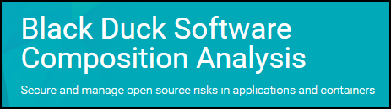
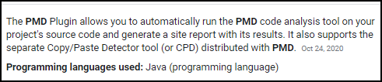
Code Testing Extensions, Continued

Slide 39
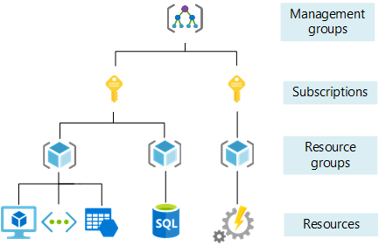
Azure Management Scopes

Slide 40
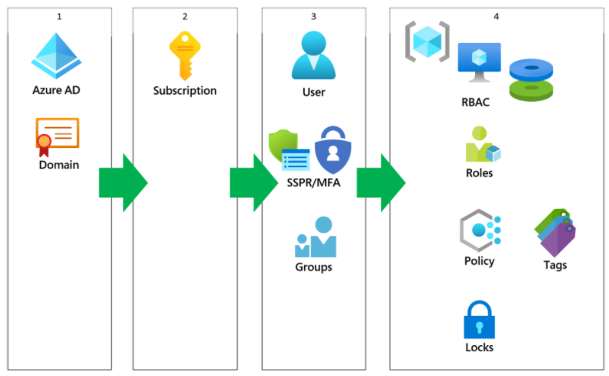
Azure AD Identity

Slide 41
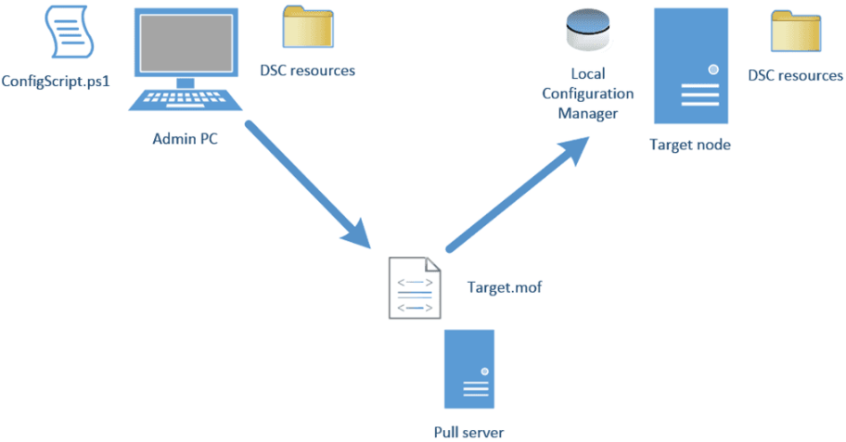
Azure Automation DSC

Slide 42
Azure Management Scopes

Slide 43
Build Automation with Azure Pipelines

Slide 44
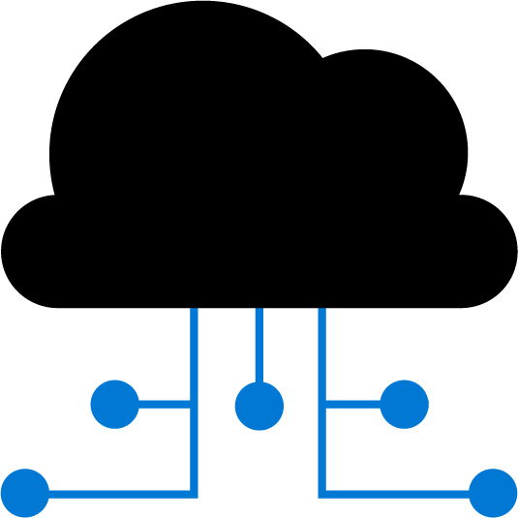

Azure pipelines and visual designer
Configure your pipelines with the Visual Designer
Continuous Integration
Continuous Deployment
Edit Code
Push to code repo
Build tasks
Test tasks
Create artifact
Release tasks
Deploy to target
Create and configure your build and release pipelines.
Push your code to your version control repository.
The build creates an artifact that’s used by the rest of your pipeline.
Your code is now updated, built, tested, and packaged.
Often referred to as "Classic Pipelines"

Slide 45
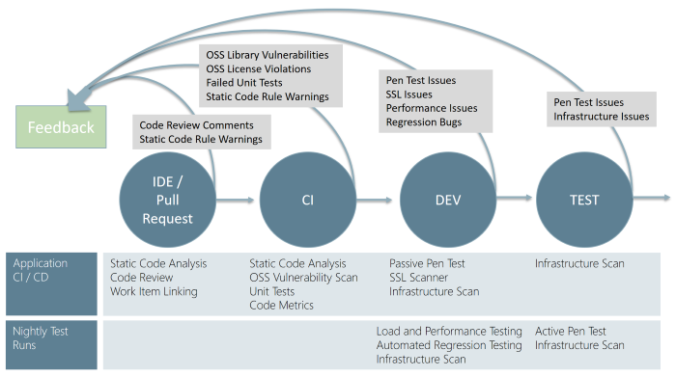
Continuous Security Validation

Slide 46
Microsoft vs self-hosted agents
You generally need at least one agent to build or deploy your project.
An agent is installable software that runs one build or deployment job at a time.
Two types of agents:
Microsoft-hosted agents – Automatically take care of maintenance and upgrades. Each time you run a pipeline, you get a fresh virtual machine. The virtual machine is discarded after one use. There are time limits on jobs run on these agents.
Self-hosted agents – You take care of maintenance and upgrades that give you more control to install dependent software needed. You can install the agent on Linux, macOS, Windows machines, or even in a Linux Docker container. There are no time limits on these jobs.

Slide 47

Hosted Agent Folders and Predefined Variables
C:\agent\_work\1\s
$(Build.SourcesDirectory)
C:\agent\_work\1\b
$(Build.stagingDirectory)
C:\agent\_work\1\a
$(Build.ArtifactStagingDirectory)

Slide 48
Predefined agent pool – Azure pipelines
Hosted VS2019
Hosted VS2017
Hosted Ubuntu 20.04
Hosted Ubuntu 18.04
Hosted Ubuntu 16.04
Hosted macOS X Mojave 10.14
Hosted macOS X Catalina 10.15

Slide 49

Azure pipelines and YAML
Configure your pipelines in a YAML file that exists alongside your code
Edit Code
Edit YAML file
Push to code repo
Azure Pipelines
Deploy to target
Configure Azure Pipelines to use your Git repo.
Edit your azure-pipelines.yml file to define your build.
Push your code to your version control repository.
Your code is now updated, built, tested, and packaged.
While more code-oriented, defining pipelines using YAML is preferred

Slide 50
The four pillars of continuous integration
Continuous Integration
Version Control System
Package Management System
Continuous Integration System
Automated Build Process
A Version Control System manages changes to your source code over time.
A Package Management System is used to install, uninstall, and manage software packages.
A Continuous Integration System merges all developer working copies to a shared mainline several times a day.
An Automated Build Process creates a software build including compiling, packaging, and running automated tests.
Notes:
Cover the software examples shown in the student materials.

Slide 51
Anatomy of a pipeline
Name – Though often this is skipped (if it is skipped, a date-based name is generated automatically)
Trigger – More on triggers later, but without an explicitly trigger, there’s an implicit “trigger on every commit to any path from any branch in this repo”
Variables – These are “inline” variables (more on other types of variables later)
Job – Every pipeline must have at least one job
Pool – You configure which pool (queue) the job must run on
Checkout – The “checkout: self” tells the job which repository (or repositories if there are multiple checkouts) to checkout for this job
Steps – The actual tasks that need to be executed: in this case a "script" task (script is an alias) that can run inline scripts

Slide 52
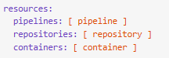
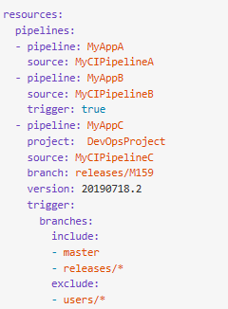
YAML resources
Pipelines
Containers
Repositories
Types

Slide 53
What are actions ?
Automations within the GitHub environment
Often used to build CI/CD implementations
Based on YAML files living within GitHub repositories
Executed on GitHub or self-hosted runners
Large number of existing actions in the GitHub Marketplace

Slide 54
Actions flow
Events
Events trigger workflows:
- Schedule, code, etc.
Workflows contain jobs:
- May contain multiples
Jobs use actions:
- Configured within steps
Trigger
Workflows
Contain
Jobs
Use
Actions

Slide 55
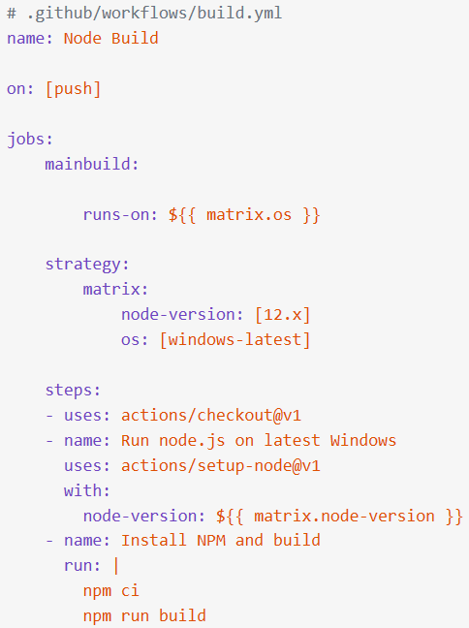
Workflows
Define the required automation:
Events, Jobs
Written in YAML
Stored in .github/workflows
Starter workflows available

Slide 56
Dependency Management with Azure Artifacts

Slide 57
Elements of a Dependency Management Strategy
Standardization
Package formats and sources
Versioning

Slide 58
Identifying Dependencies
Find components and source code that can have independent:
Deployment
Release
Versioning
Things to consider:
Change frequency
Changes should be unrelated to other parts of system
Can package exist by itself
Package should add value for others

Slide 59



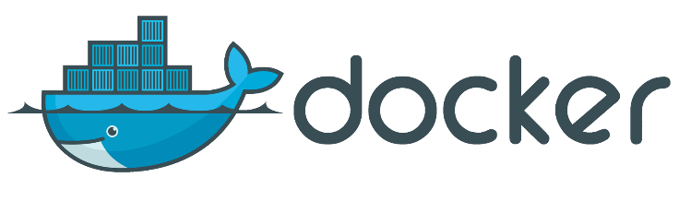
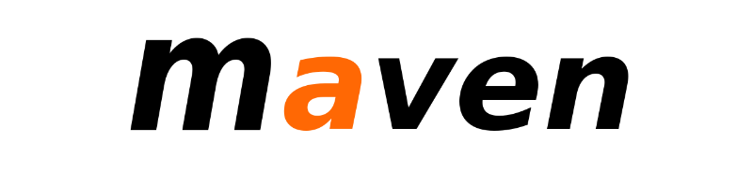
Packages
A package is a formalized way of creating a distributable unit of software artifacts that can be consumed from another software solution.
Microsoft platform and .NET artifacts
Node.js modules
Python scripts
Universal packages
Java packages
Docker images
NuGet Microsoft development platform and .NET artifacts
Npm node.js modules
Maven Java packages
Python Python script
Universal Set of related files
Docker Container images
Symbols Symbol files

Slide 60
Package feeds
Centralized storage of package artifacts:
Public or privately available
Offer secure access for private feeds
Versioned storage of packages
Managed by tooling
Also known as:
Package repositories
Package registry
Package Types:
Public: NuGet.org, Npmjs.org, PyPi.org, Docker Hub
Private: MyGet, Azure Container Registry, Azure Artifacts, Self-hosted solutions

Slide 61
Securing access to package feeds
Feeds have to be secured:
Private feeds
Not allow access by unauthorized users for publishing
Restricted access for consumption:
Whenever a package feed and its packages should only be consumed by a certain audience, it is required to restrict access to it. Only those allowed access will be able to consume the packages from the feed.
Restricted access for publishing:
Secure access is required to restrict who can publish, so feeds and their packages cannot be modified by unauthorized or untrusted persons and accounts.

Slide 62
Exam AZ-400 Exam Strategy

Slide 63
Preparing for Online Testing

Slide 64
Tim's Online Testing Video
timw.info/online

Slide 65

Why Microsoft Online Testing?
COVID means Pearson VUE physical testing centers are unavailable
The Pearson OnVUE client has come a LONG way
I'll use online testing exclusively from now on

Slide 66

Pearson OnVUE System Requirements
Windows 10 / Windows 8.1
macOS High Sierra (10.13)
4 GB RAM
1024x768/16 resolution
1920x1080/32 recommended
Touchscreens are prohibited

Slide 67

Pearson OnVUE System Requirements
3 Mbps down/up network bandwidth
Mobile hotspot tethering is prohibited
Browsers:
IE 11, Edge, Chrome, Firefox, or Safari (latest versions)

Slide 68

Pearson OnVUE System Requirements
Webcam: 640x480/10 fps
Microphone: integrated
Headsets not allowed
Corporate VPNs, firewalls, and proxies will likely disrupt the delivery
Check with networking team first

Slide 69
Your Pre-Exam Checklist
Computer set up
Kill all tasks except for your browser
May need to use Task Manager or Activity Monitor
Additional monitors turned off
Mobile phone
ID

Slide 70
During the Exam
Keep your face in the webcam frame
Keep your hands away from your mouth
Ensure you aren't interrupted
Walled room
Door closed
No bio breaks are allowed

Slide 71
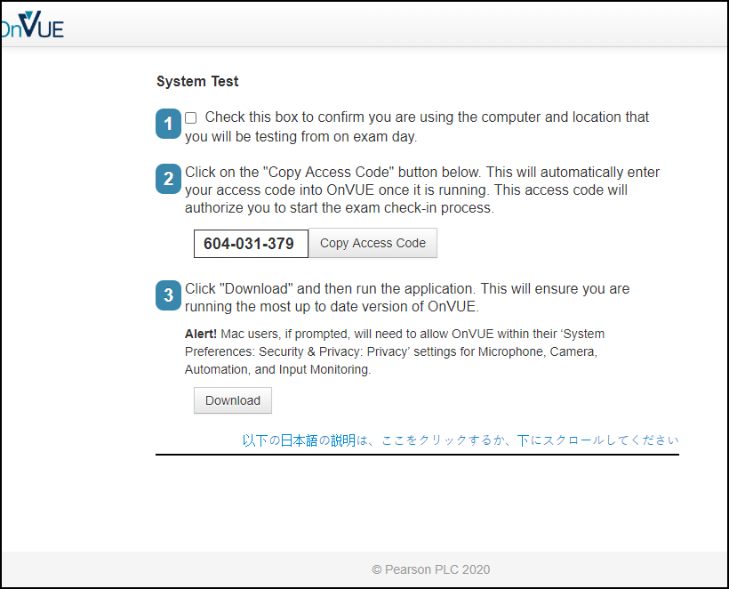

Slide 72
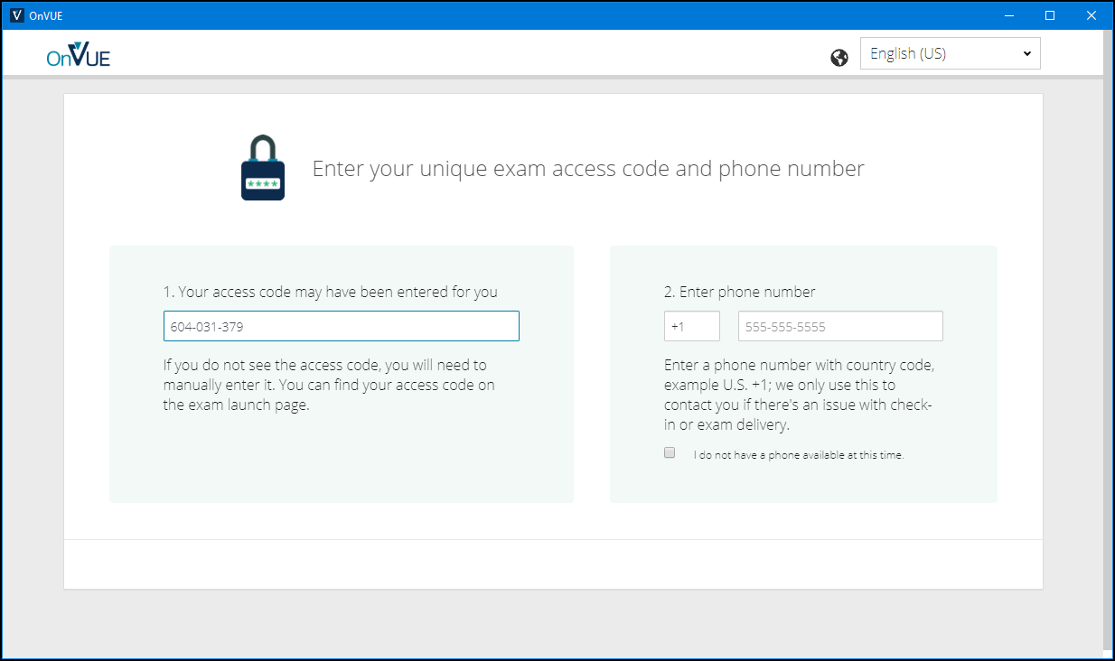

Slide 73
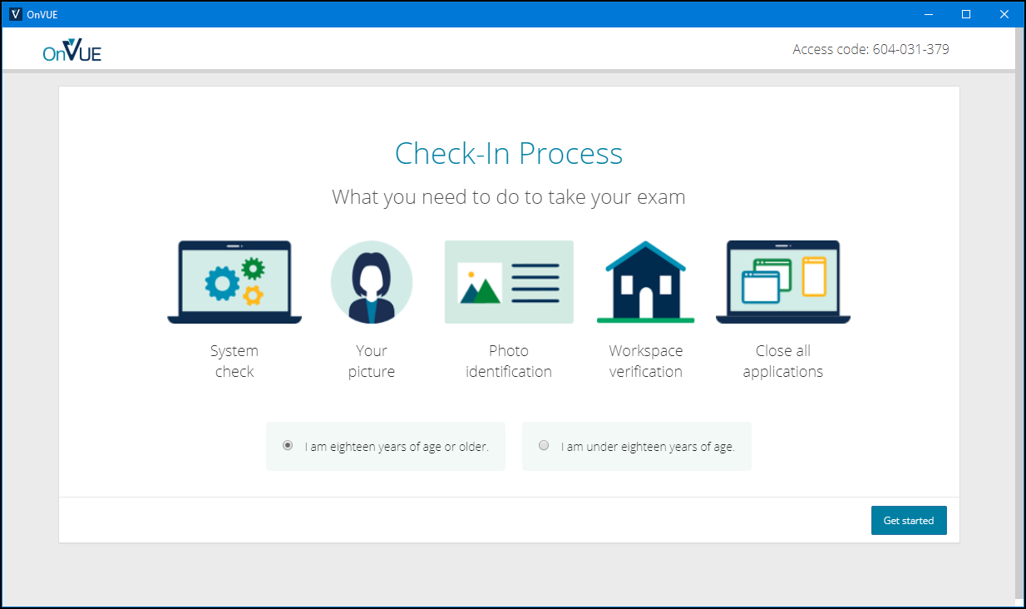

Slide 74
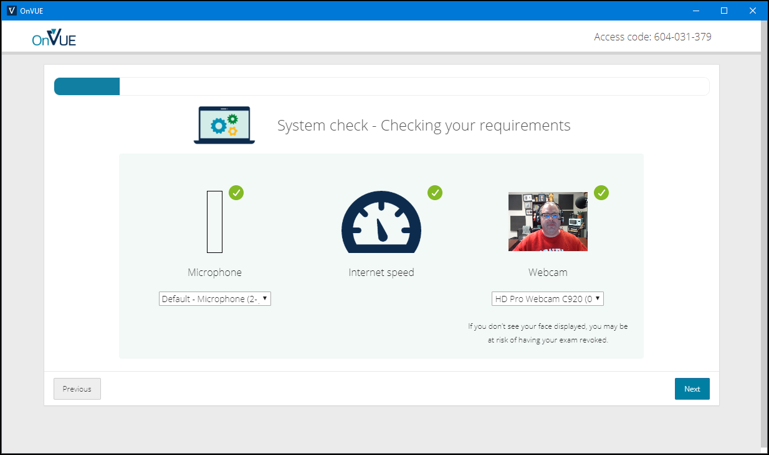

Slide 75
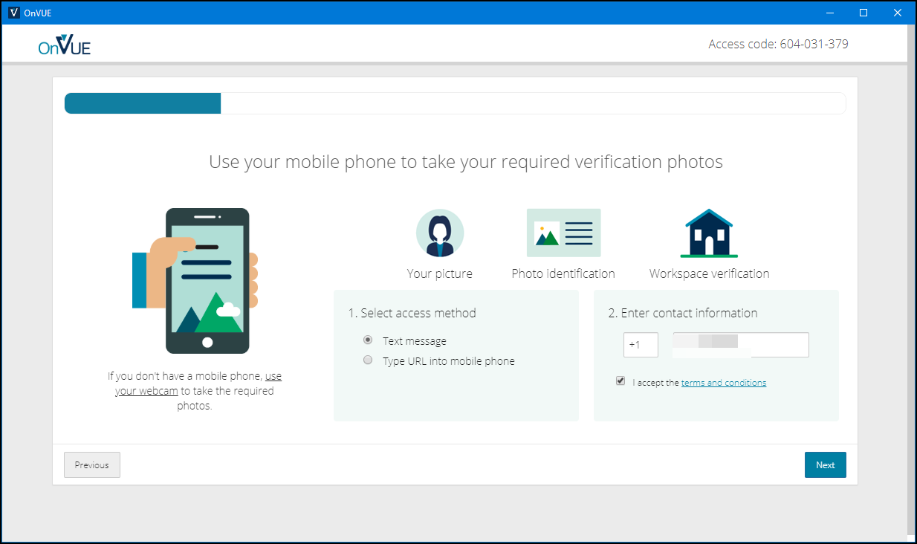

Slide 76
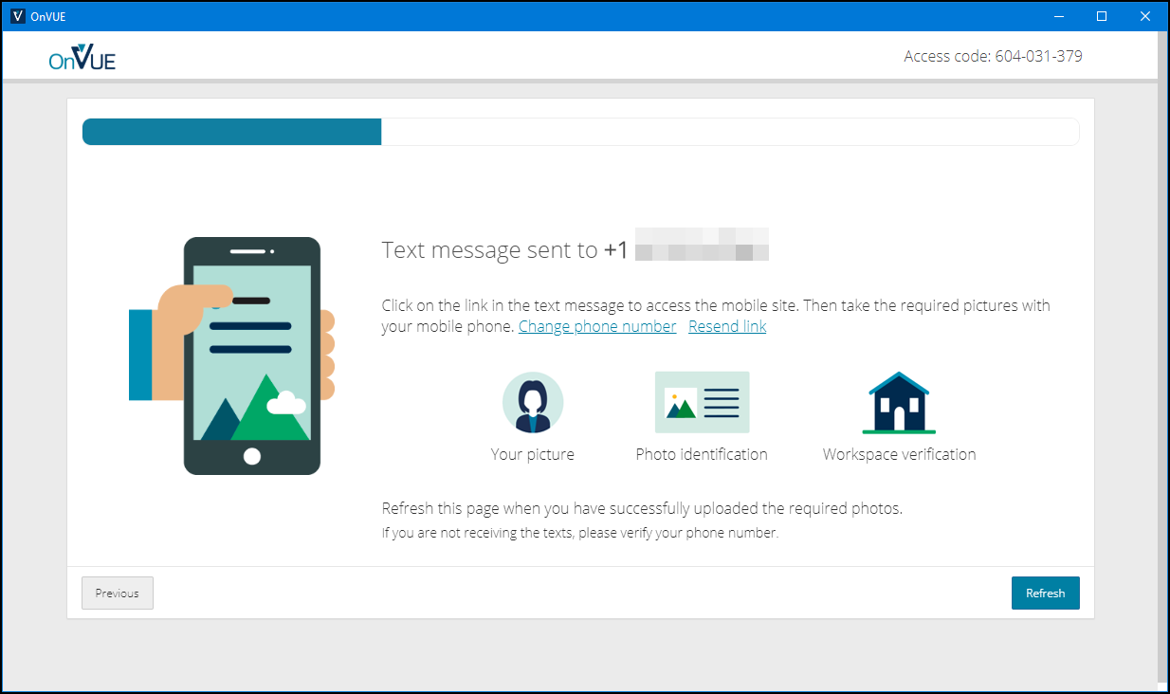

Slide 77
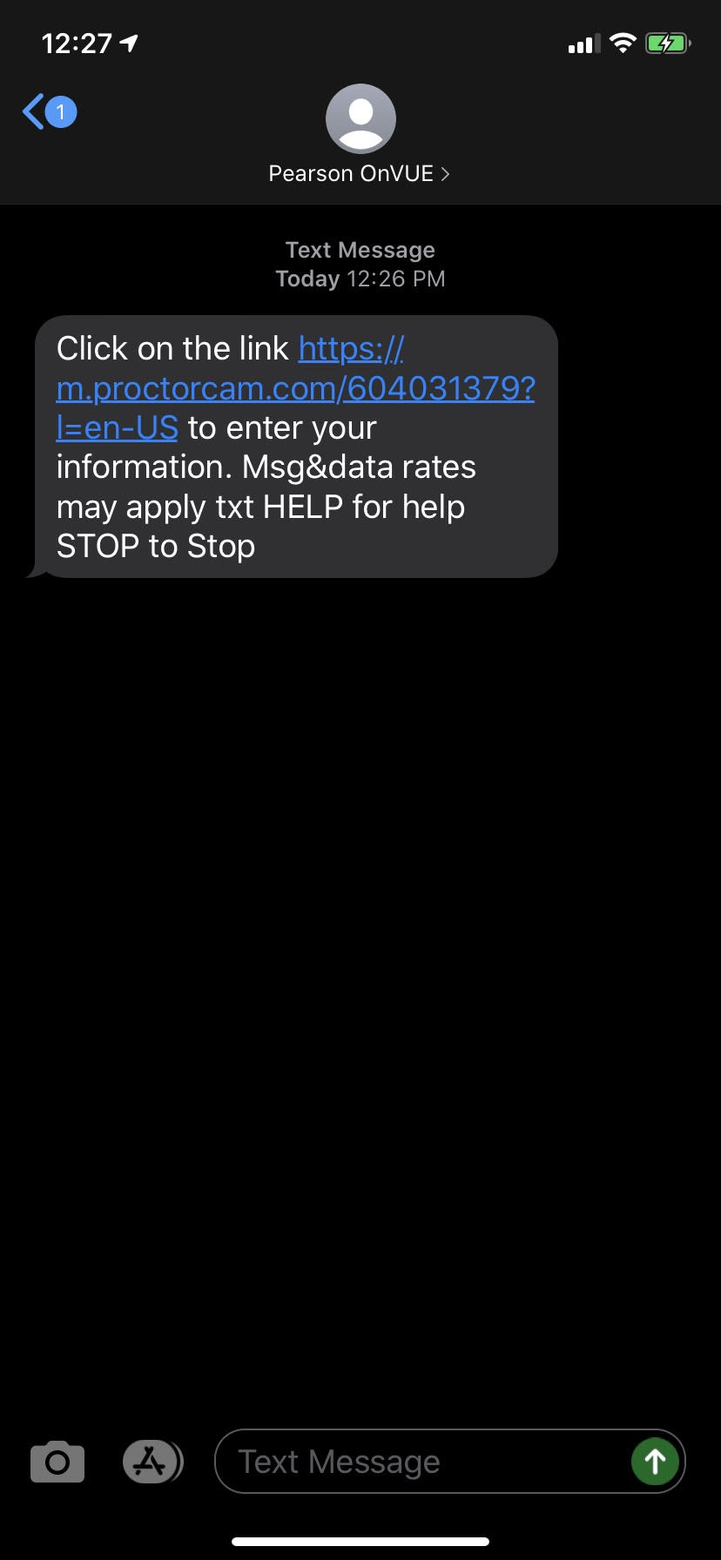
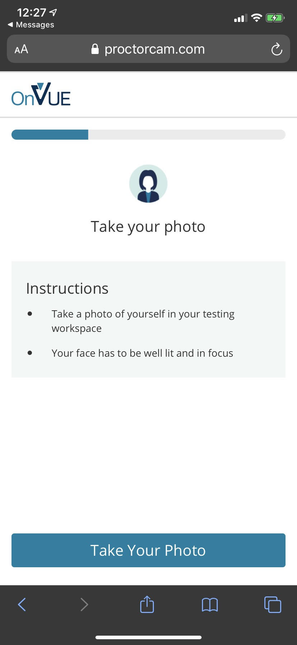
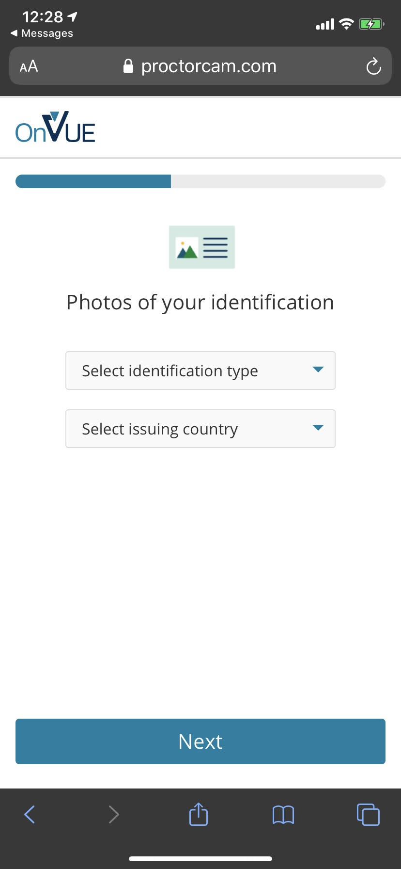

Slide 78
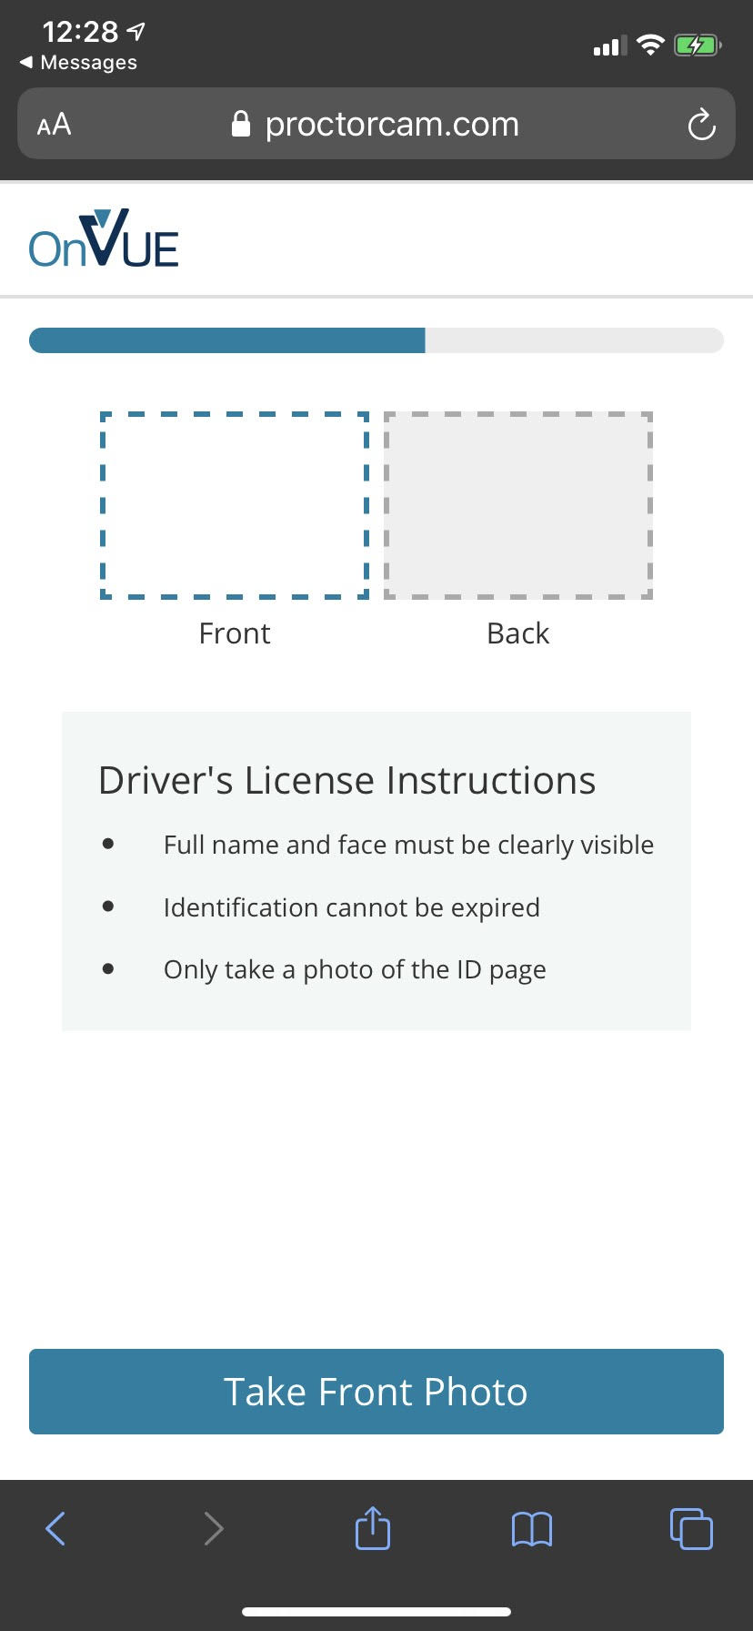
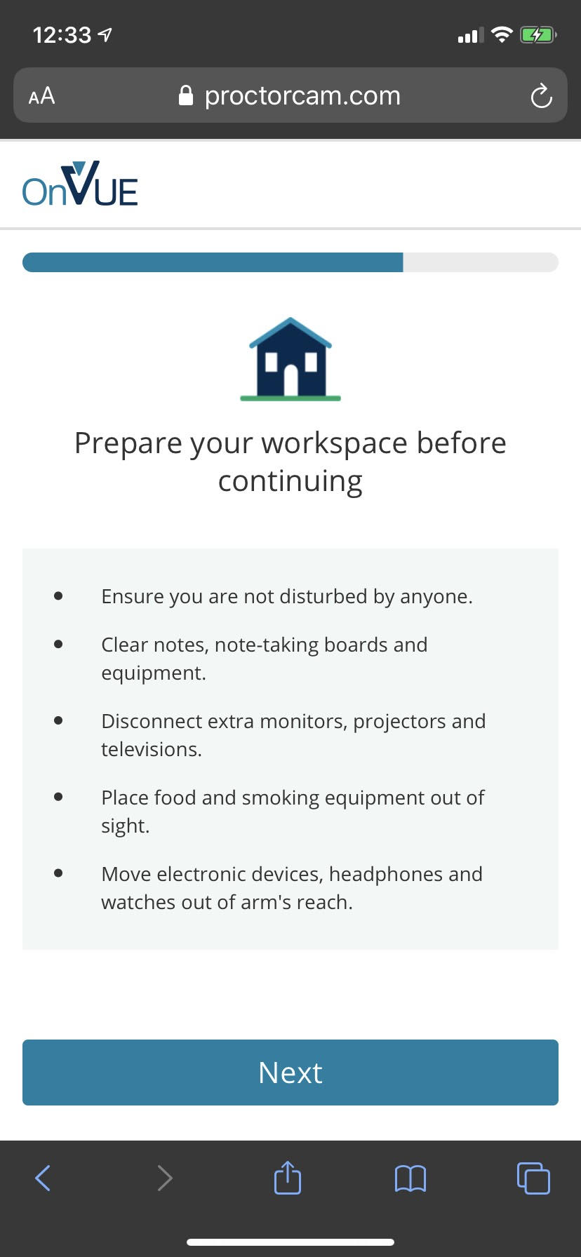

Slide 79
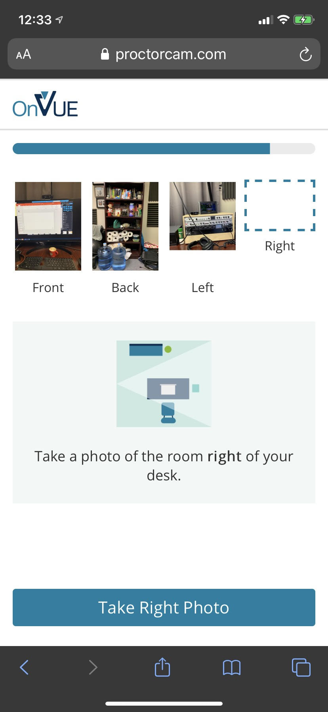


Slide 80


Slide 81


Slide 82


Slide 83
AZ-400 Exam Tips
Expect to see a lot of JSON, PowerShell, and Azure CLI
Expect NOT to see C# or JavaScript
It doesn't matter which exam order you use:
AZ-203
AZ-103/AZ-104
AZ-400
Perform due diligence in validating your environment for Microsoft online testing

Slide 84
AZ-400 Item Types

Slide 85

Single Answer Multiple Choice

Slide 86

Multiple Answer Multiple Choice

Slide 87
Repeated Scenario
You need to move an Azure VM to another hardware host.
Solution: You redeploy the VM.
Does this solution meet the goal?
Yes
No

Slide 88
Repeated Scenario
You need to move an Azure VM to another hardware host.
Solution: You restart the VM.
Does this solution meet the goal?
Yes
No

Slide 89

Select and Place

Slide 90

Build List and Reorder

Slide 91

Active Screen/Fill in the Blank

Slide 92

Case Study

Slide 93






Performance-Based Lab

